Slide 1



Fundamentals of Nursing II (1st Stage)
Second Semester/ 2022-2023
Oxygenation
Lecture 6: Theory

Slide 2
Lecture outline
Overview of anatomical and physiological of breathing
Assessing oxygenation
Oxygen therapy
Alteration in respiratory function

Slide 3
Oxygenation
The delivery of oxygen to the body’s tissues and cells is called oxygenation.
Respiration is a process of gas exchange, it's necessary to supply cells with O2 for metabolism and to remove CO2. The mechanisms of respiration require an integration of factors involving:
(1) nervous system.
(2) chemoreceptors in cardiovascular system, as well as (3) the respiratory system.
Notes:
3

Slide 4
Oxygenation
The respiratory system provides the essential first process in this integrated system, that is movement and transfer of gases between the atmosphere and the blood. Impaired function of the system can significantly affect our ability to breathe, transport gases, and participate in everyday activities. Clients with compromised oxygenation status need careful assessment and thoughtful nursing care to achieve an adequate and comfortable level of oxygenation function
Notes:
4

Slide 5
Glossary
Eupnea: normal respiration its quiet, rhythmic, and effortless.
Tachypnea: rapid respiration; it is seen e.g., with fevers, metabolic acidosis.
Bradypnea: abnormally slow respiration; which may be seen in clients who have taken drugs such as sedatives, who have metabolic alkalosis, or who have IICP (e.g., from brain injuries).
Apnea: absence of breathing.
Orthopnea: inability to breathe easily only with stand or sitting position.
Dyspenea or shortness of breath (SOB): difficulty breathing.
Exertional dyspnea: Difficulty breathing with activity.
Notes:
5

Slide 6
Glossary
Hypoventilation: inadequate alveolar ventilation, may be caused by either slow or shallow breathing, or both. It is may occur because of diseases of the respiratory muscles, drugs, or anesthesia.
Hyperventilation: increased movement of air into and out of the lungs.
Pneumothorax: Air or gas in the pleural cavity.
Hemothorax: Accumulation of blood in the pleural space.
Pleural effusion: Excessive fluid in the pleural space.
Oxygen saturation: amount of oxygen combined with hemoglobin.
Notes:
6

Slide 7
Glossary
Hypoxemia: reduced oxygen levels in the blood.
Hypoxia: insufficient oxygen in the body tissues.
Anoxia: without oxygen.
Hypercapnia or hypercarbia: increased blood levels of CO2.
Cyanosis: bluish discoloration of the skin, nail beds, and mucous membranes due to reduced hemoglobin-oxygen saturation
Notes:
7

Slide 8
Overview of anatomical and physiological of breathing
The respiratory system is divided structurally into:
1. Upper respiratory system (the mouth, nose, pharynx, and larynx).
2. Lower respiratory system (the trachea, and lungs with the bronchi, bronchioles, alveoli, pulmonary capillary network, and pleural membranes).
Notes:
8

Slide 9
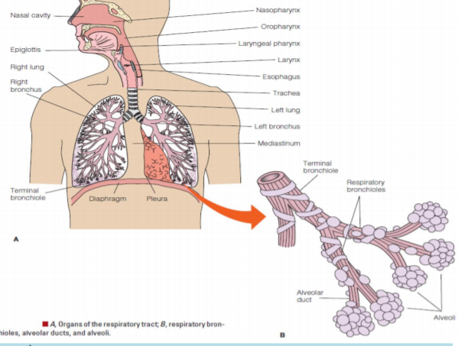

Slide 10
Physiology of Oxygenation:
Involves four components, include:
1. Pulmonary ventilation or (breathing):
The movement of air into the lungs (inspiration or inhalation) and out of the lungs (expiration or exhalation) for the purpose of delivering fresh air into the lung’s alveoli. The rate and depth of ventilation are adjusted in response to changes in the concentrations of:
a) Hydrogen ion (pH) in the body’s fluids. A decrease in the body’s fluids pH will stimulate faster and deeper ventilation.
b) CO2 in the body’s fluids, an increase in CO2 in the blood will stimulate faster and deeper ventilation.
c) Blood O2 concentration
Notes:
10

Slide 11
Adequate ventilation depends on several factors:
a) Open and clear airways (cough reflex and ciliary action keep airway open and clear).
b) An intact CNS and respiratory center (respiratory center located in medulla oblongata and pons in the brainstem).
c) An intact thoracic cavity capable of expanding and contracting.
d) Adequate pulmonary compliance and recoil. (Expansion and recoil of the lungs occurs passively in response to changes in pressures within the thoracic cavity and the lungs themselves)

Slide 12
Physiology of Oxygenation:
2. Alveolar-capillary gas exchange:
involve the diffusion of O2 and CO2 between the alveoli and the pulmonary capillaries, it's also referred to as oxygen uptake or external respiration.
3. Transport of O2 and CO2:
involves the transport of the respiratory gases between the tissue and the lungs.
O2 needs to be transported from the lungs to the tissues, and CO2 must be transported from the tissue back to the lungs.
Notes:
12

Slide 13
Physiology of Oxygenation:
Factors affect the rate of O2 transport from the lungs to the tissues include:
a. Cardiac output: any pathologic condition that decreases cardiac output diminishes the amount of O2 delivered to the tissues.
b. Number of erythrocytes and blood hematocrit (Hct):
Excessive increases in the blood Hct raise the blood viscosity reducing the cardiac output and reducing the O 2 transport.
Excessive reduction in the blood Hct reducing the O2 transport.
c. Exercise: increased cardiac output and to increased use of O2 by the cells.
4. Systemic diffusion:
O2 diffuses from the blood to the tissues, while CO2 moves from the tissues to the blood; It is referred to as internal respiration.
Notes:
13

Slide 14
Factors affecting oxygenation:
1. Age: Oxygenation status can be influenced by age.
2. Environmental factor: Heat, cold and air pollution affect oxygenation.
Clients who are exposed to dust, animal dander, or toxic chemicals in the home or workplace are at increased risk for alterations in oxygenation.
Smokers and those exposed to second-hand smoke should be questioned as to the type, amount and number of years of exposure.
3. Lifestyle Factors: lifestyle factors can affect a client’s oxygenation status: emotion
Notes:
14

Slide 15
Factors affecting oxygenation:
4. Disease Processes: Oxygenation alterations can often be traced to disease states related to alterations in ventilation, alveolar gas exchange, oxygen uptake, or circulation. Many disease states may affect oxygenation, including COPD, atelectasis, atherosclerosis, heart failure, and anemia.
Notes:
15

Slide 16
Factors affecting oxygenation:
5. Medications: a variety of medications can decreases rate and depth of respirations. The most common medications are; sedative-hypnotics and antianxiety drugs e.g., diazepam; and narcotics such as morphine.
6. Stress: the sympathetic nervous system is stimulated and epinephrine is released during stress and causes the bronchioles to dilate
Notes:
16

Slide 17
Alternation in respiratory function:
A. Conditions affecting airway patency: A completely or partially obstruction of the airway, can occur anywhere along the upper or lower respiratory passageways as a result of the presence of foreign body, or accumulation of mucus or inflammatory exudates.
Partial obstruction of the upper airway is indicated by a low-pitched snoring sound during inhalation.
Notes:
17

Slide 18
Alternation in respiratory function:
Complete obstruction of the upper airway is indicated by extreme inspiratory effort that produces no chest movement and an inability to cough or speak
Lower airway obstruction is not always as easy to observe.
Stridor, a harsh, high-pitched sound, may be heard during inspiration.
Notes:
18

Slide 19
Alternation in respiratory function:
B. Conditions affecting movement of air into and out of the lungs: condition affecting the rate, volume, rhythm, and relative ease or effort of respiration.
example; dyspnea, orthopnea, tachypnea, bradypnea, and apnea.
C. Conditions affecting diffusion of O2 and CO2 between alveoli and pulmonary capillaries: e.g., pulmonary edema, atelectasis, and anemia.
Notes:
19

Slide 20
Alternation in respiratory function:
D. Conditions affecting the transport of oxygen and carbon dioxide via the
blood to and from the tissue cells: Conditions that decrease cardiac output
such as heart failure or hypovolemia, affect tissue oxygenation, and the
body's ability to compensate for hypoxemia.
Notes:
20

Slide 21
Impaired Oxygenation:
  Can be life-threatening
  Mild to severe
  Diseases, injuries
  Frightening, frustrating

Slide 22
Assessment:
What do you see?
(Examples include restlessness, anxiety, gasping, cyanosis, shortness of breath, increased respiratory rate?)
Notes:
Restlessness / anxiety
Gasping
Swelling around lips mouth or tongue
Obviously rapid or slow breathing
Cyanosis is a late finding

Slide 23

Notes:
Oxygenation – AIRWAY

Slide 24
Assessment:
What do you hear?
(With your ears and/or with your stethoscope…)
Notes:
Normal breath sounds are the inspiratory and expiratory sounds heard through the chest wall of a healthy individual

Slide 25
Normal breath sounds are the inspiratory and expiratory sounds heard through the chest wall of a healthy individual.

Slide 26
Do you hear coughing, wheezing, gasping, or any other sounds during breathing?

Slide 27
Q. Ventilation is also known as
_______? a. Wheezing b. Pneumonia c. Breathing d. Lung Abscess

Slide 28

c. Breathing

Slide 29

Quality of breathing requires a patent airway, one that is open and free of obstruction.

Slide 30
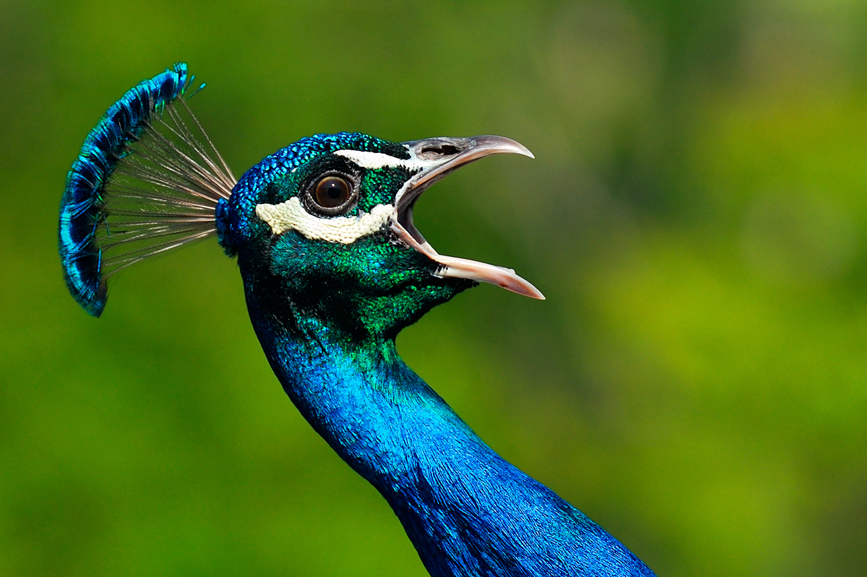
A priority for the nurse is to always make certain the patient has a patent airway!

Slide 31
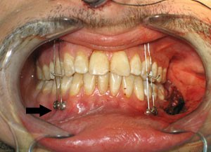
Airway patency is a priority with patient status changes, facial/dental surgery, upper respiratory tract obstruction, and emergency situations!

Slide 32
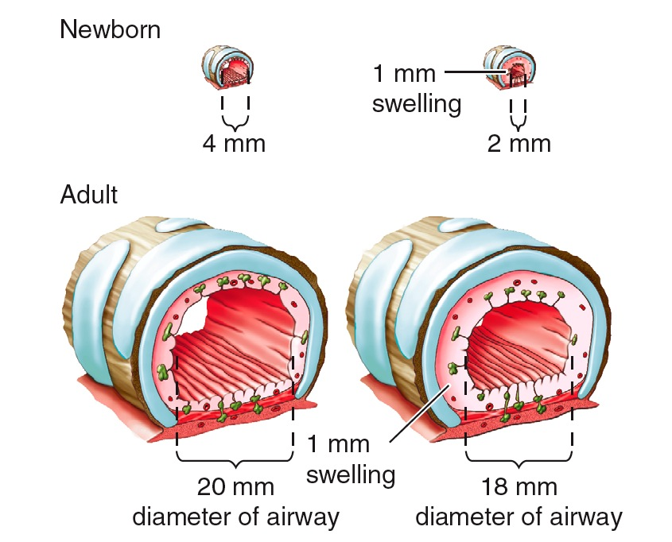
When edema and swelling of the trachea/airway occur in response to a virus, bacterium, or other irritant, the airway is further narrowed.
Notes:
The smaller the airway the more occlusion swelling causes – newborn little lungs little airway

Slide 33
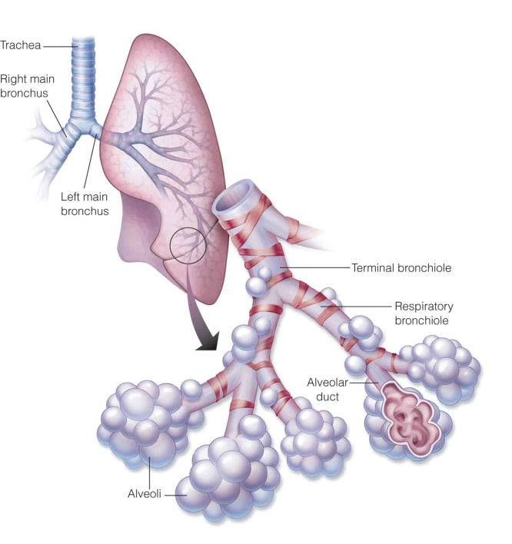
Think of diffusion as oxygen getting into the blood and carbon dioxide getting out…
(Remember: gas exchange.)
Notes:
Diffusion – oxygen getting into the blood and carbon dioxide getting out

Slide 34
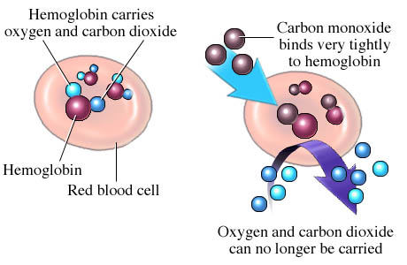
* Hemoglobin is the oxygen-carrying molecule within the red blood cells (RBC’s).
* No RBC’s or hemoglobin; no oxygen!
* Pulse Oximeter measures percentage of oxygen attached to hemoglobin
Notes:
Oxygen carried by red blood cells – hemoglobin
No RBC’s or hemoglobin no oxygen Pulse Oximeter only measures percentage of o2 attached to hemoglobin – if only one hemoglobin can still read 100%

Slide 35
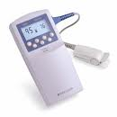
Oxygen Saturation:
Pulse Oximeter is used to measure the percentage of oxygen attached to hemoglobin
Notes:
TOOL Pulse oximetry only measure o2 bound to hemoglobin

Slide 36

When assessing respiratory status changes, determine if the patient is…

Slide 37
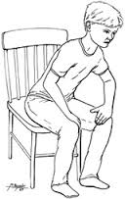
Tripod Position: Leaning forward with the hands on the knees

Slide 38
Q. What is the first thing you do when someone has difficulty breathing? a. Have them raise their feet b. Sit them up in high upright position c. Give them water to drink d. Take their blood pressure

Slide 39
b. Sit them in an upright position

Slide 40

21

